Slide 1
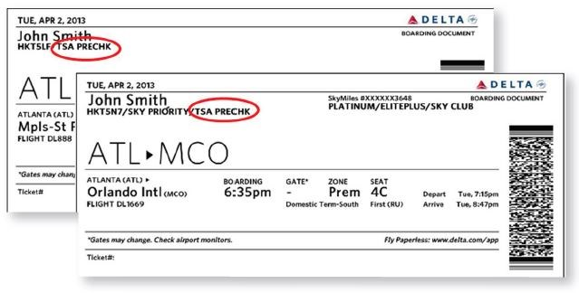
Assumptions/Omissions
Potential variables not considered:
Air Line issues: The number one cause of flight delays are factors within the air line’s control. Issues such as maintenance, crew and hiring, cleaning, fueling, and baggage loading.
Inclement weather. Major weather events such as tornados, snow storms, heavy rain, and fast winds make it unsafe for an airplane to take off.
Airport security issues. Acts of vandalism, terrorism, threats, and extended security screenings will cause major delays in flights
Heavy airport volume. Heavier than average volume in travelers can cause long lines for ticketing, TSA screening, and general operations. Months with major holidays such as December will have heavier airport traveler volume.
Late arriving aircraft. When a previous flight arrives late it has a ripple effect causing other departing flights to be delayed.
Airport staffing issues. Malperformance or absence of TSA, ticketing staff, and air traffic controllers may have contributed to delays.
The government shutdown started in December 2018. Due to the Christmas and New Year holidays, December has higher than average air travel volume which could contribute to the delays in this time period.
https://www.bts.gov/topics/airlines-and-airports/understanding-reporting-causes-flight-delays-and-cancellations

